Slide 1
The Basics of hosting a website
and
Web servers

Slide 2
What is a web server?
Basically it’s a piece of software that processes web content.

Slide 3
How does it work?
Listen ----- To a network port for a request
On a port ----- port :80 (HTTP) and port :443 (HTTPS)
For a Request ----- with the HTTP protocol
Transport protocol ----- TCP and UDP dependable on port
Response ----- Returns a HTTP based response
Resource ----- local file / external database /

Slide 4
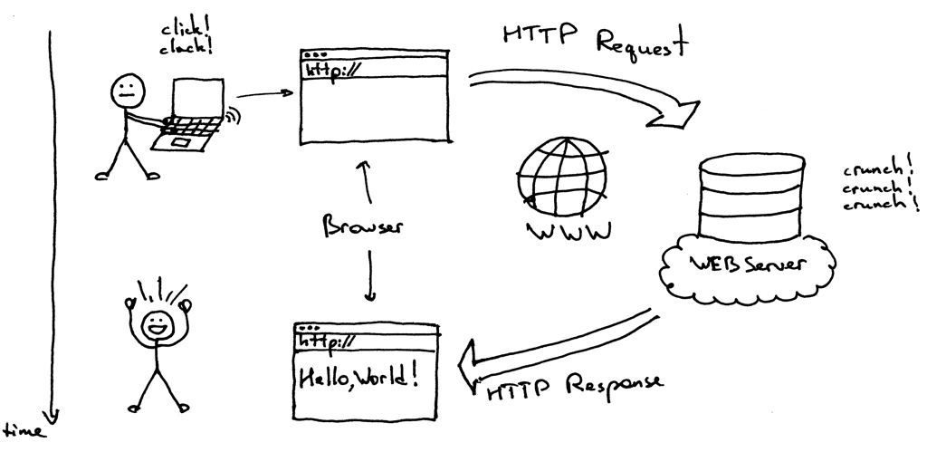
Basic working flow

Slide 5
Things to do with your home server
Store personal files
Chat server
(Jabber)
Host personal website
Email server
Tor node
Bitcoin node
Lightning node
Make a VPN

Slide 6
How to host a website?
If you need a website, it will need to be hosted somewhere!

Slide 7
Pay someone else to do it for you
or
Do it yourself !

Slide 8
Some important features
Hosting:
cloud, VPS,...
Help & Support:
customer support resources
Features:
From site backups to WordPress integration
Up Time:
The reliability of server uptime.
Value:
Added costs, freebies, and money-back policies

Slide 9
Your hosting plan:
Shared:
multiple sites, one server
=> cost effective
Cloud:
powered by multiple servers.
more flexible system
Virtual Private Server
(VPS):
You share server space with other sites, but a section of it is entirely yours.
Dedicated:
You get all the resources. Exclusivity costs, but it’s worth it if your site is resource-intensive.

Slide 10
Get a Domain Name
It’s all well and good having a plot of internet land, but without an address no one will be able to find it!
Purchase from specialist domain name registrars such as Domain.com and link it to your hosting account.

Slide 11

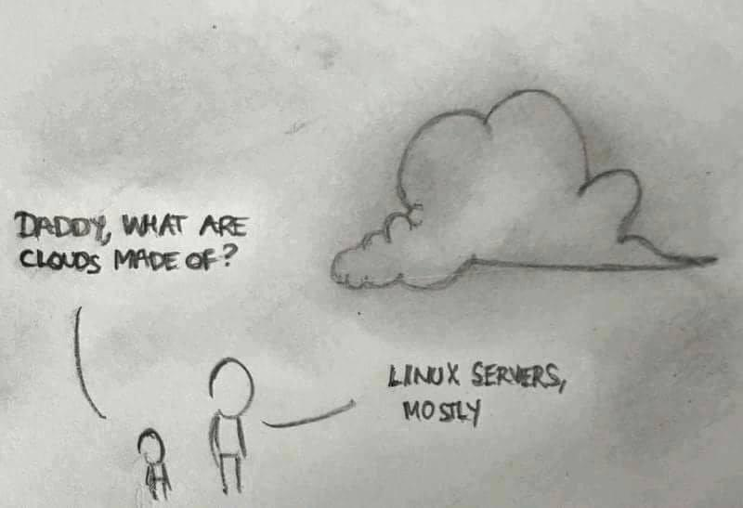

Slide 12
How to Host a Website Locally
Use your Windows PC as a WAMP serve Windows, Apache, MySQL, and PHP
Step 1: Install WAMP software. ----------- WampServer and XAMPP
Step 2: Upload site files.
Step 3: Make your website public.
Use a Linux machine:
Step 1: Install LAMP software. ----------- Linux, Apache, MySQL, and PHP
Step 2: Configure site files and DNS. ------ Add files to the root directory
Step 3: configure Apache. -------- Tell Apache to accept visitors requests.

Slide 13
Apache HTTP Server
Open Source cross platform server

Slide 14
How to install and run Apache web server in Ubuntu Linux
Open the terminal ctrl+alt+t
Sudo apt-get update
Sudo apt-get install apache2
If not started automatically, service apache2 start
Ifconfig (to see your IP adress)
Test in your webbrowser – localhost – 127.0.0.1 – your IP
Netstat -an | more (to check your ports)
Cd var/www/html (to change your index.html)

Slide 15

Questions?
Yes, please!

